Slide 1
Cloud Career Insights Dashboard Empowering Careers in the Evolving World of Cloud Computing
Presented by Team 17: Krishna Chaitanya Reddy Kallam
Sai Kandi
Josh Rajesh Reddy Katakam
Jasmithi Karri
Nishanth Kannepogu
Mahender Reddy Kamidi

Slide 2
Why This Project? (Context & Purpose)
Rising demand for cloud computing professionals
Need for market intelligence around:
🔹 Hiring trends
🔹 Salary benchmarks
🔹 Skill demands
🔹 Industry/company dynamics
Purpose:
Support job seekers, recruiters, and educators with actionable insights
Guide upskilling and hiring strategies
Empower smarter career and talent decisions

Slide 3
Intended User Profile - Understanding Our User
Target User Profile
HR Manager or Senior Recruiter in a mid-to-large tech firm
Job seekers exploring cloud computing roles
Organizational Hierarchy
HR Manager reports to Director of Talent Acquisition
A job seeker is a career-focused individual with moderate technical awareness
Thought Process
Focused on decision-makers in hiring and professionals seeking career data
Assumed users have a basic understanding of job roles and skill requirements in tech

Slide 4
Decision-Making Needs of the User
Key Areas of Responsibility:
Hiring Planning & Talent Acquisition
Skill Gap Assessment
Salary Benchmarking
Dashboard Support:
Identifies in-demand roles and locations
Compares salaries by job title, region, and work type
Highlights essential skills for competitive hiring
Challenges:
Aligning salary structures across sources
Skills data categorization
Courses That Helped:
Applied Analytics (Prof. Ben Gonzalez): Data structuring and filtering
Visualization, Feedback & Dissemination (Prof. Keith Hacke): Dashboard design principles

Slide 5
Data Validation and Preparation
Key Tables Used:
jobs.csv: job_id, title, listed_time, city, state
salaries.csv: min_salary, max_salary, med_salary, pay_period
skills.csv + job_skills.csv: skill_name, job_id
companies_cleaned.csv: employee_count, follower_count
industries_cleaned.csv
Validation Approach:
Cross-referenced job counts across datasets
Verified outliers in salary and skill frequencies
Transformations:
Normalized salary (hourly → annual)
Created unified location field (city, state, country)
Skill category mapping (business, soft, technical)
Created salary buckets & job duration columns
Tools: Power Query, Excel Join/Merge

Slide 6
Design of the User Interface
Color Theme: Soft beige background, purple sidebar for navigation
Navigation: Vertical icons on the left for seamless movement
Interactivity: Slicers for employment type, job title, pay period, company size, etc.
Visual Types: Bar charts, pie charts, KPIs, donut charts, gauge
Accessibility: Clear labels, font consistency, intuitive layout

Slide 7
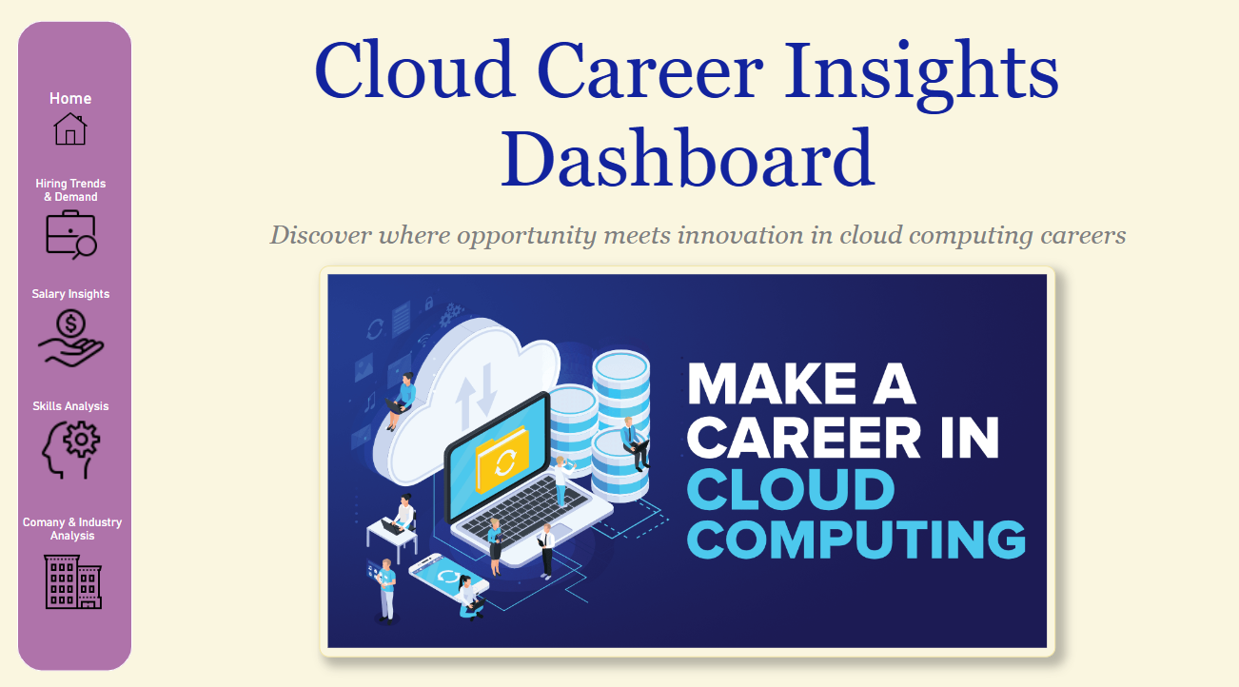
Home Page
Purpose: Welcomes users and introduces the goal of the application.
Visuals:
Catchy headline: “Make a Career in Cloud Computing”
Subtitle: “Discover where opportunity meets innovation in cloud careers”
Sidebar Navigation with icons: Quick access to each section (Hiring Trends, Salary, Skills, Companies)
User Value: Acts as a landing page that orients users and promotes exploration.

Slide 8
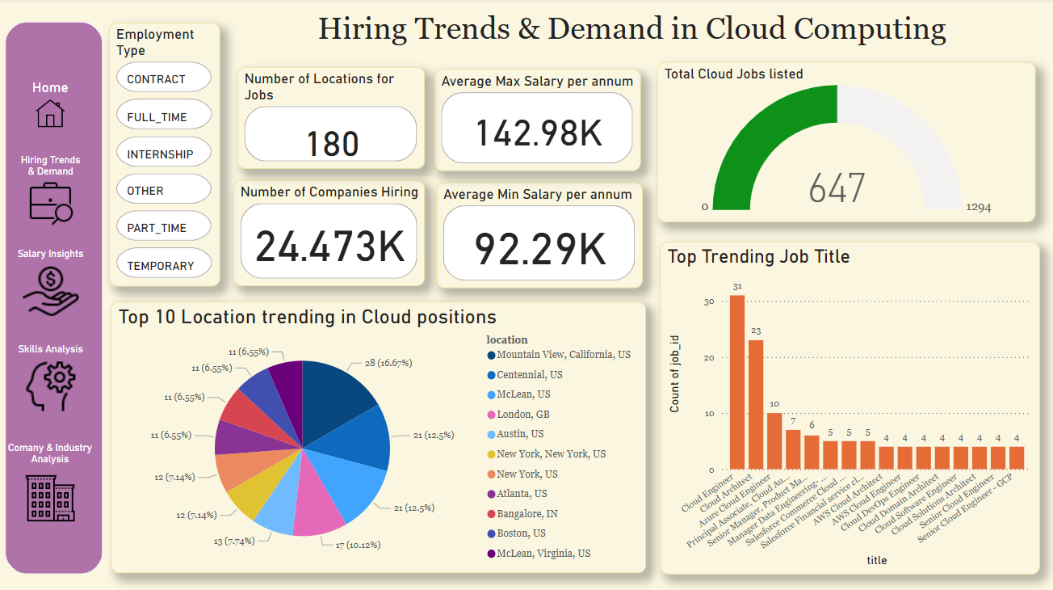
Hiring Trends & Demand Insights
Key KPIs
Number of Companies Hiring (24.4K)
Number of Locations for Jobs (180)
Average Min & Max Salary (92.29K & 142.98K)
Total Cloud Jobs Listed: Gauge showing 647 cloud-specific roles out of 1294 jobs posted
Top Visuals
Bar chart: Top trending job titles (Cloud Engineer, Architect, Azure roles)
Pie chart: Top 10 locations (Mountain View, London, Bangalore)
Slicers
Employment type (Full-time, Contract, etc.)
User Impact
Helps job seekers discover where cloud opportunities are growing
Helps recruiters target the right locations and roles for postings

Slide 9
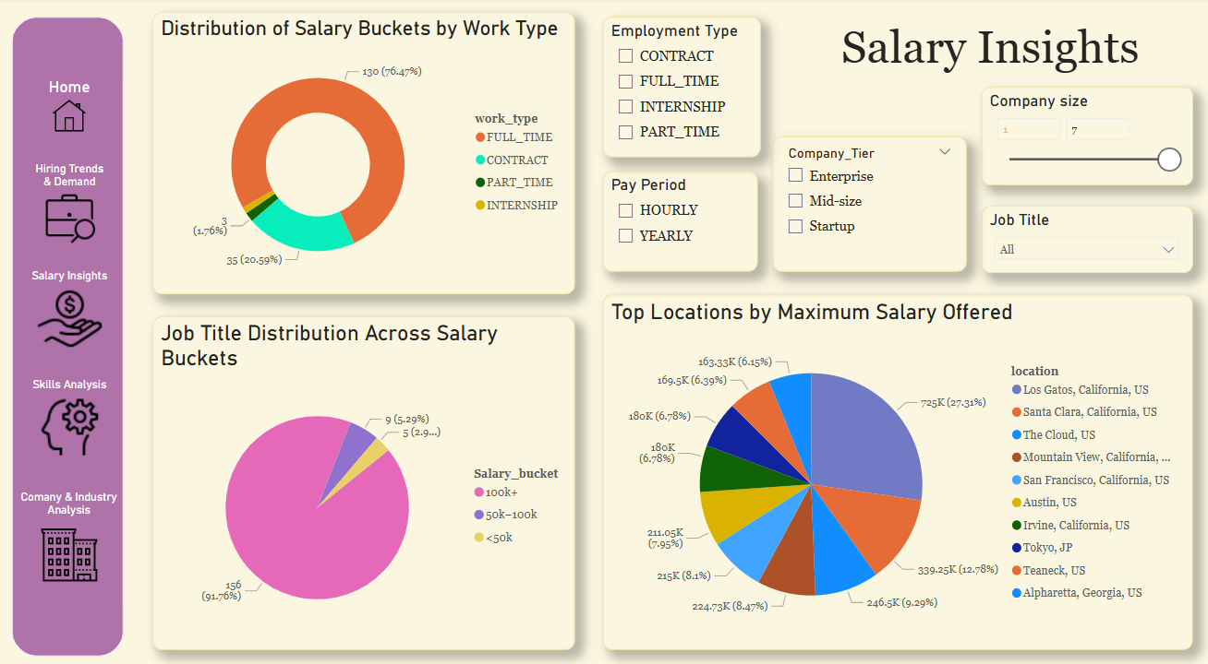
Salary Insights
Key KPIs:
Salary distribution across employment types
Average and maximum salaries by job title, location, and company size
Top Visuals:
Donut Chart: Salary buckets by work type
Pie Chart: Job title distribution across salary categories
Pie Chart: Top locations by max salary
Slicers:
Company size
Employment type
Pay period (hourly vs yearly)
Company tier
User Impact:
Job seekers can set realistic salary expectations
Recruiters can benchmark compensation
Helps understand how company size and job type affect pay

Slide 10
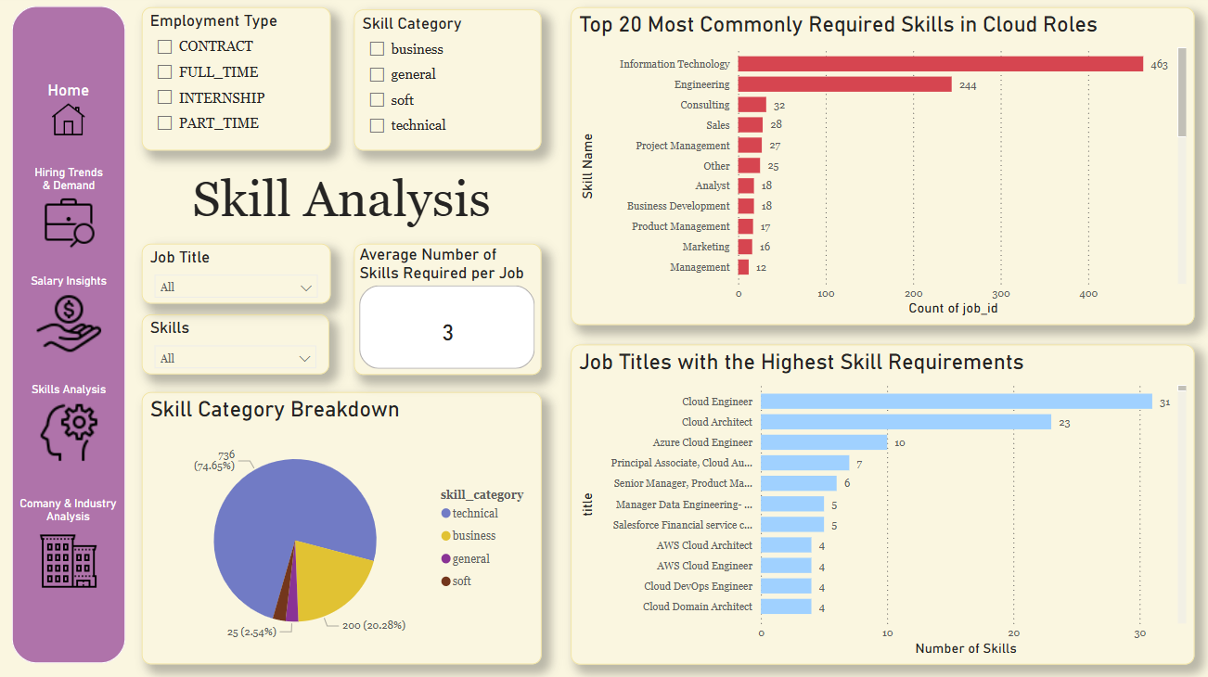
Skill Analysis
Key KPIs:
Average number of skills per job
Skill category (Technical, Business, Soft, General)
Top Visuals:
Bar chart: Most in-demand skills (IT, Engineering, Consulting)
Bar chart: Roles with the highest skill requirements
Pie chart: Skill category breakdown
Slicers:
Employment type
Skill category
Job title
User Impact:
Job seekers can prioritize upskilling in high-demand areas
Educators can tailor courses to market needs

Slide 11
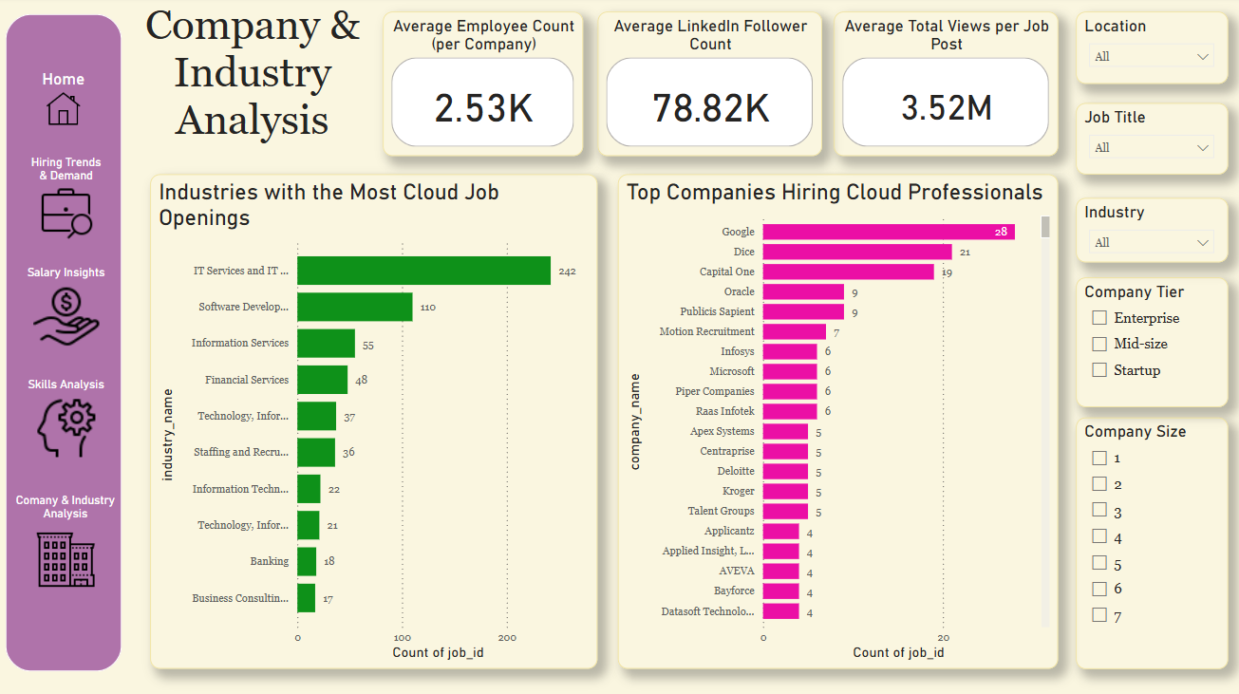
Company & Industry Analysis
Key KPIs:
Average company size, LinkedIn followers, job post views
Top Visuals:
Bar chart: Top companies hiring cloud professionals (Google, Dice, Capital One)
Bar chart: Most cloud jobs by industry (IT Services, Software Development)
Slicers:
Location
Job Title
Industry
Company Tier & Size
User Impact:
Candidates can focus on companies investing in cloud hiring
Startups and enterprises can assess competitiveness

Slide 12
Navigation, Visual Cohesion & Theming
Side Navigation Panel with clear icons enables quick page switching
Consistent Slicers (clean toggles & dropdowns) make interaction easy
Unified Visual Design:
Soft, readable theme with contrast
Color-coded visuals for skills, salary, industry
Matching layouts across all pages
Interactive Filtering: All visuals respond dynamically to user selections
User Value:
Easy to explore
Intuitive layout
Personalized insights by role, region, company size

Slide 13
Validation & Traceability
Traceability Matrix Basis
Each dashboard visual mapped to a requirement
Validated using filters, slicers, and random sampling
Verification Process
Matched data counts to original CSVs
Manually checked computed columns
Tested user flow across all filters
Conclusion
Dashboard meets decision needs for both HR professionals and job seekers
Reliable, validated insights enable confident actions

Slide 14
Thank you

